Slide 1

Biomedical Signal Processing Credit Hours = 3+1 Code NO: BME-355 Semester: 5th by Dr. Wazir Muhammad Laghari Email: wazirlaghari@buetk.edu.pk
Biomedical Engineering Department
Balochistan University of Engineering and Technology, Khuzdar

Slide 2
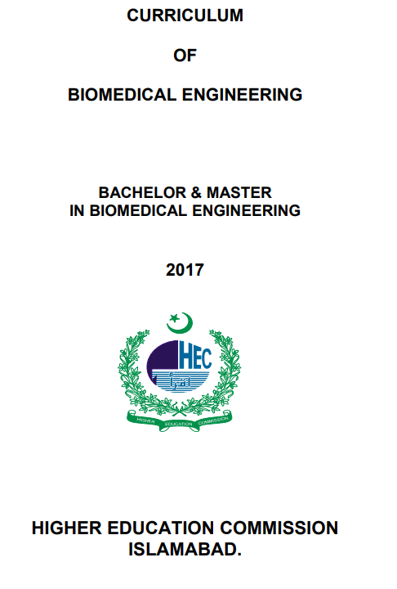
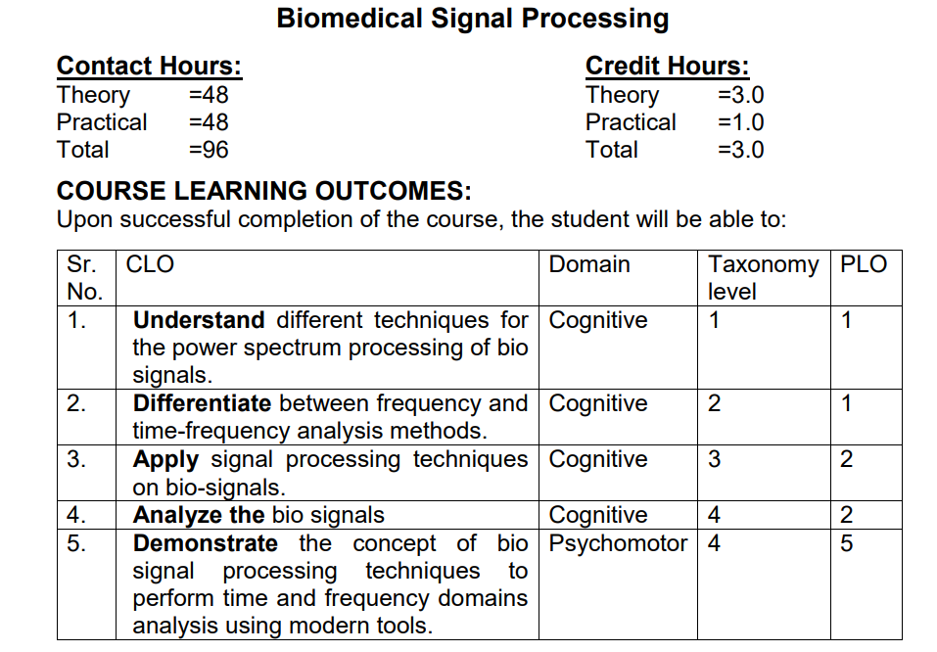
HEC CURRICULUM
https://www.hec.gov.pk/english/services/universities/RevisedCurricula/Documents/2016-2017/BIOMEDICAL-ENGG.pdf

Slide 3
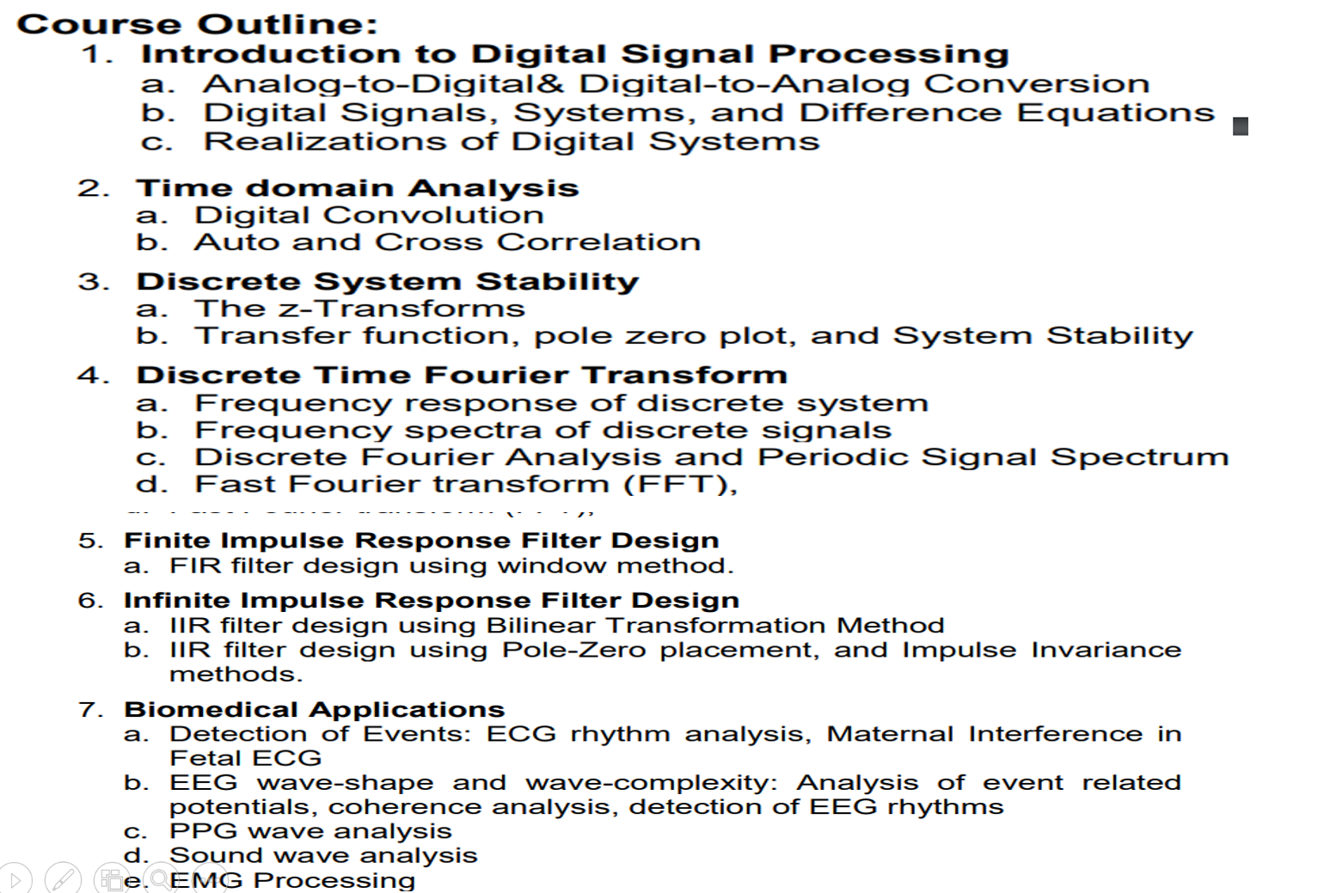

Slide 4
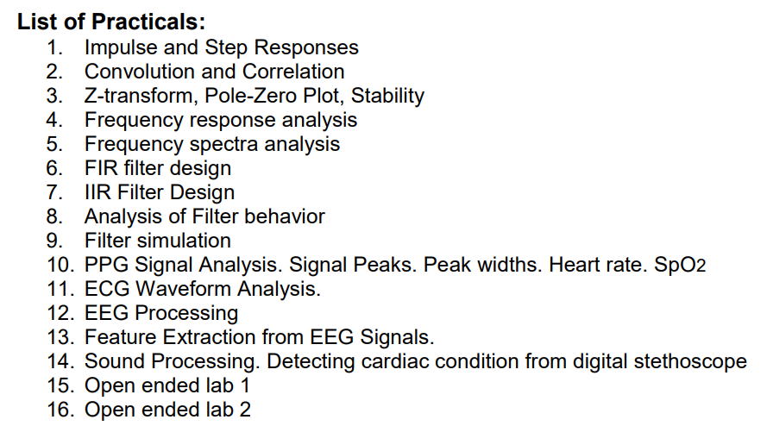

Slide 5
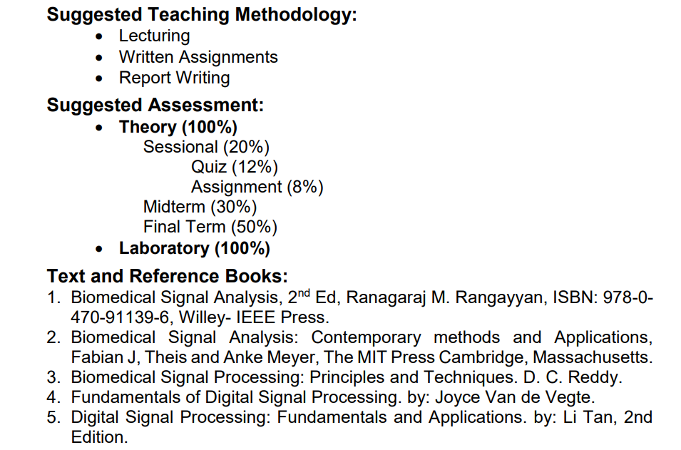

Slide 6
Course Outline
WEEK NO | TOPIC
WEEK-1 | Review of Signals and Systems
WEEK-2 | Sampling and Quantization
WEEK-3 | Discrete-Time Signals Quiz-01
WEEK-4 | Discrete-Time Systems Test-01
WEEK-5 | Z-transform and its application in the analysis of discrete LTI systems
WEEK-6 | Impulse response Quiz-02
WEEK-7 | Frequency Response Test-02
WEEK-8 | DTFT
WEEK-9 | DFT and FFT
WEEK-10 | Design and implementation of digital filters Quiz-03
WEEK-11 | Introduction to Statistical Signal Processing Test-03
WEEK-12 | Overview of feature extraction and pattern recognition techniques,
WEEK-13 | case studies of various Biomedical Signals: ECG,
WEEK-14 | case studies of various Biomedical Signals: ECG, EEG, EMG. Quiz-04
WEEK-15 | case studies of various Biomedical Signals: ECG, EEG, EMG. Test-04

Slide 7
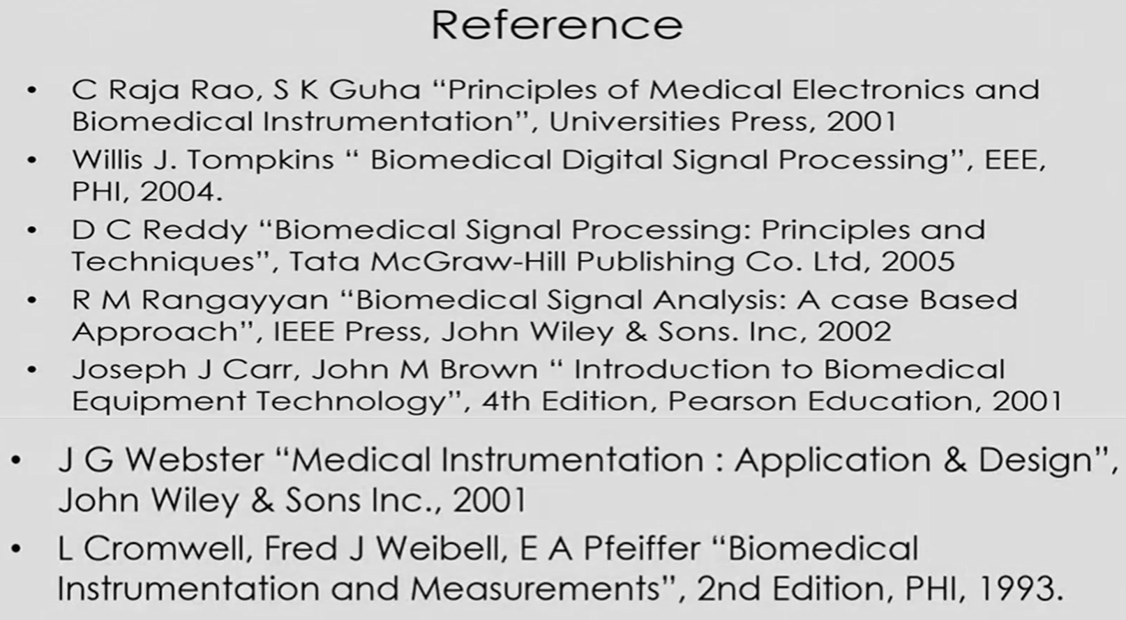

Slide 8
Biomedical Engineering
Biomedical Engineering combines biology and engineering to make technological breakthroughs in medical devices, procedures, and patient care.
Biomedical engineering (BME) is the application of engineering principles to solve biological and medical problems for the purpose of improving health care.

Slide 9
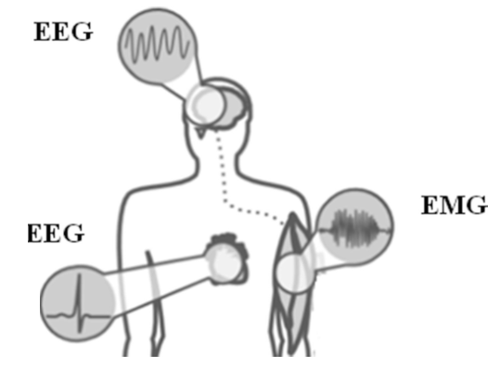
Signal
A Signal is a function that conveys information is called Signal.
In Biomedical Engineering, a signal is a record of biological activity, such as the electrical activity of the heart or brain.
Biomedical signals can be used to diagnose and monitor health, and to understand how biological systems function.

Slide 10
System
System is a group of similar and dissimilar units working together for a common purpose is known as System.

Slide 11
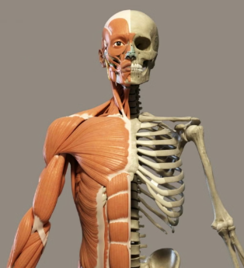
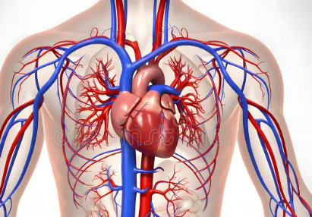
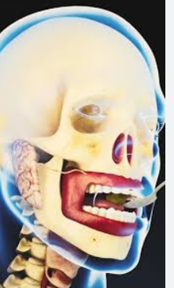
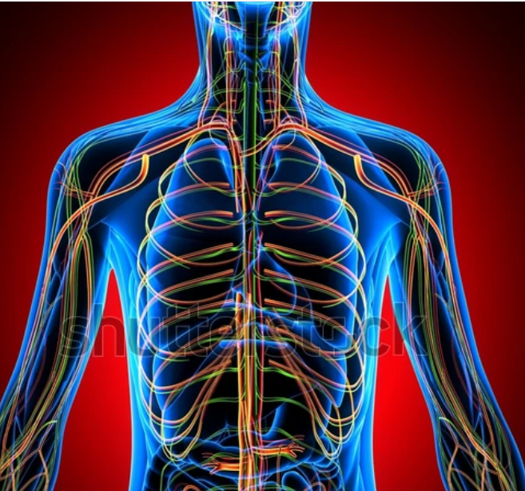
Is Human Body Is a System
Ans: Yes, because our body is a composed of many sub-systems which together enables us to do any thing.
The human body functions properly due to the coordinated action of various sub-systems.
Heart Circular System
Digestive System
Nervous System

Slide 12
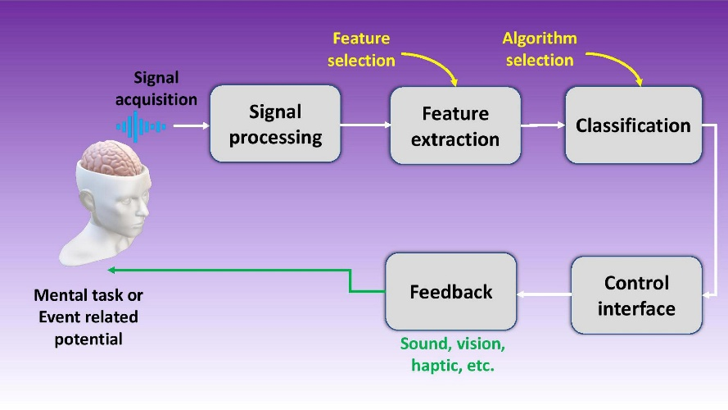
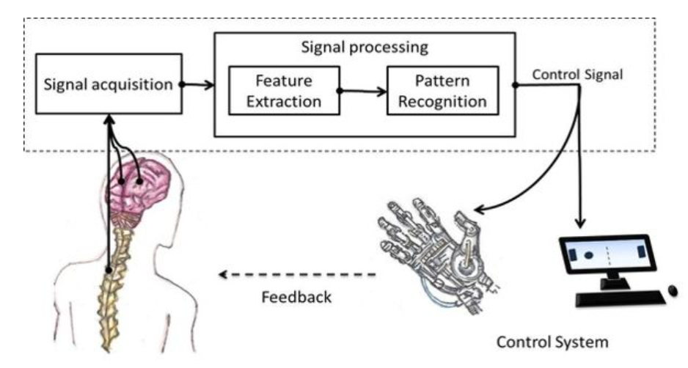
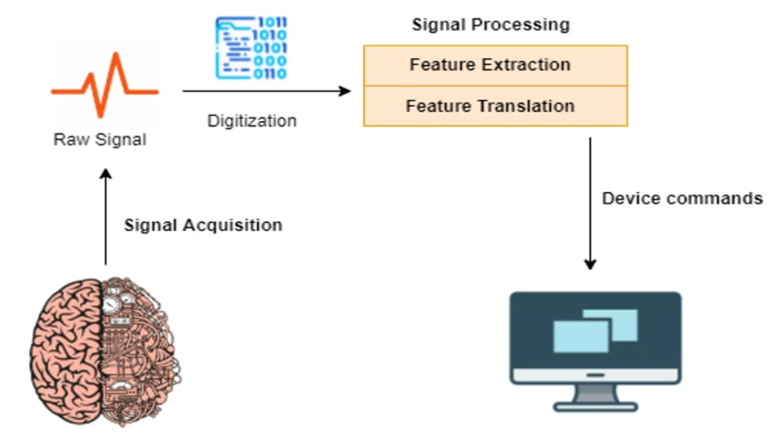
Signal Acquisition
Signal Acquisition: Collecting physiological signals using various medical instruments.

Slide 13
Biomedical Signal Processing
Biomedical refers to the application of principles and methods from engineering, physics, and mathematics to medical and biological systems.
It involves the use of technology and scientific techniques to understand, diagnose, and treat medical conditions.
In the context of biomedical signal processing, it specifically involves analyzing and interpreting biological signals, such as those from electrocardiograms (ECGs), electroencephalograms (EEGs), and electromyograms (EMGs), to extract valuable physiological and clinical information.

Slide 14
Basic Applications of Biomedical Signal Processing

Slide 15
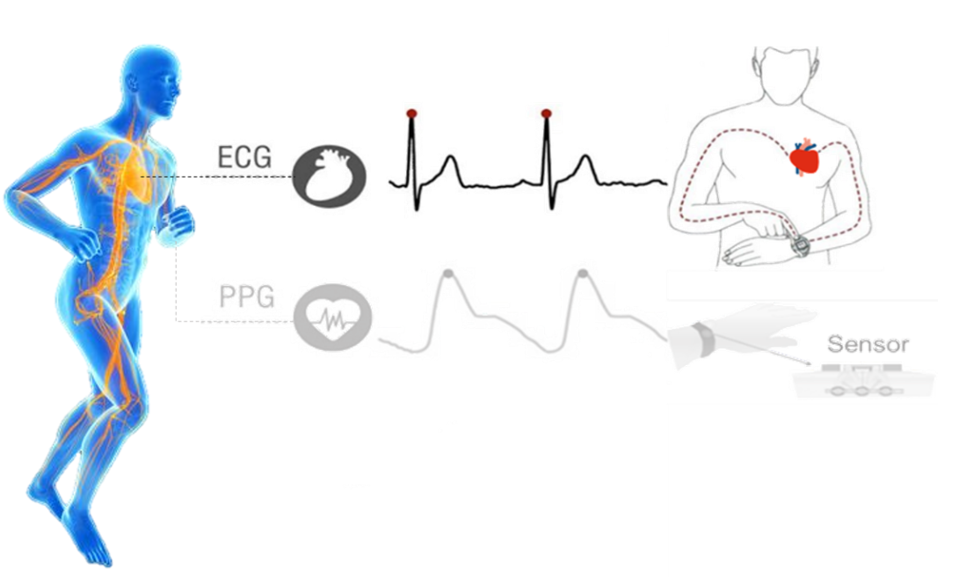
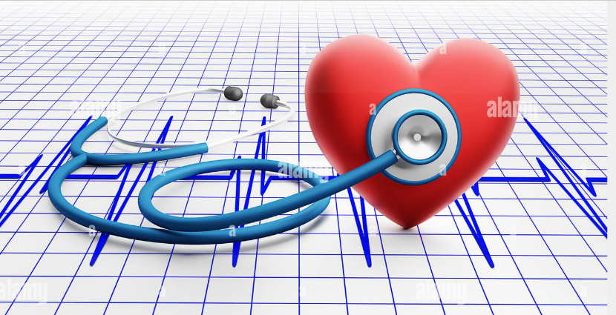
1- ECG (Electrocardiogram)
An ECG (electrocardiogram) is a test that records the electrical activity of your heart, including the rate and rhythm.
It’s usually quick and painless process.

Slide 16
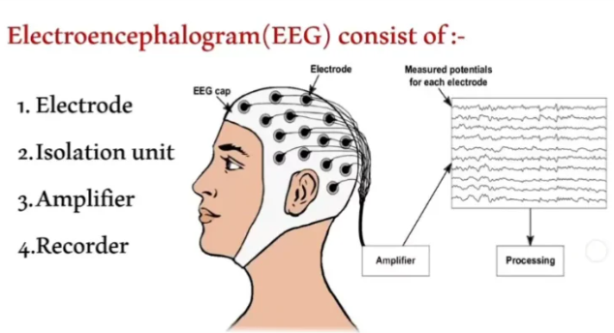
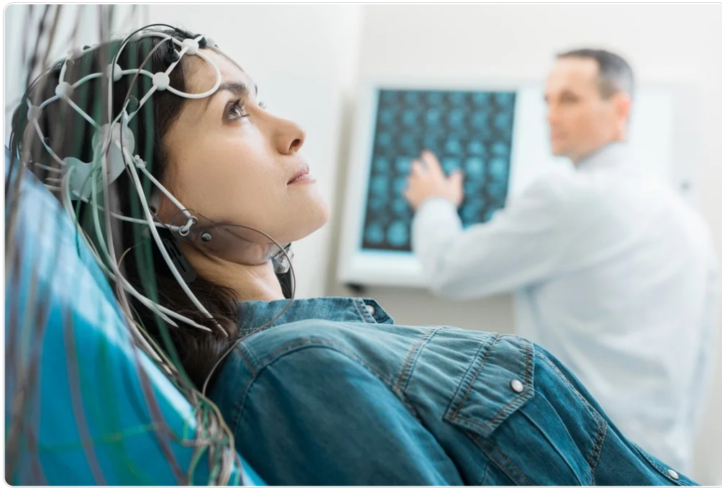
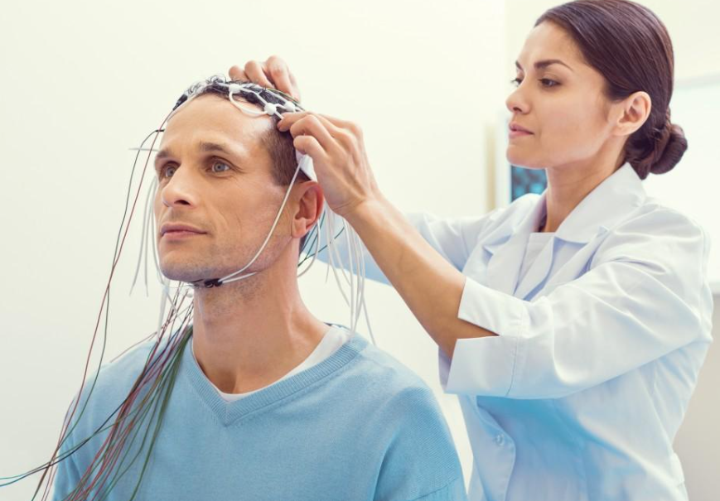
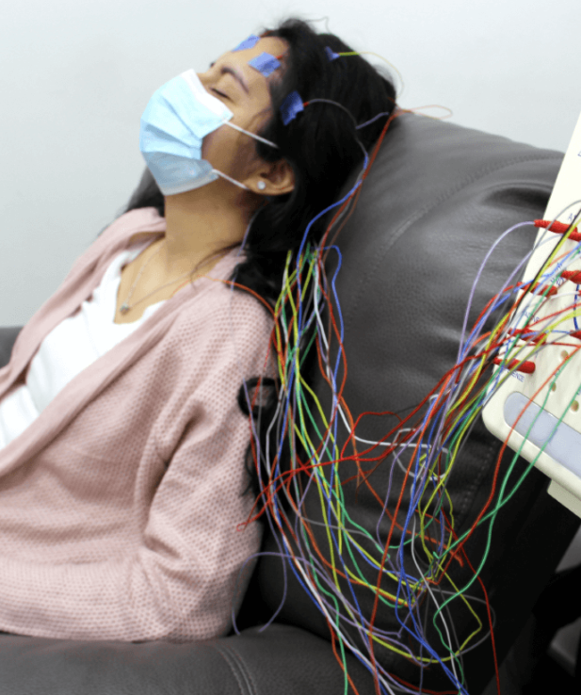
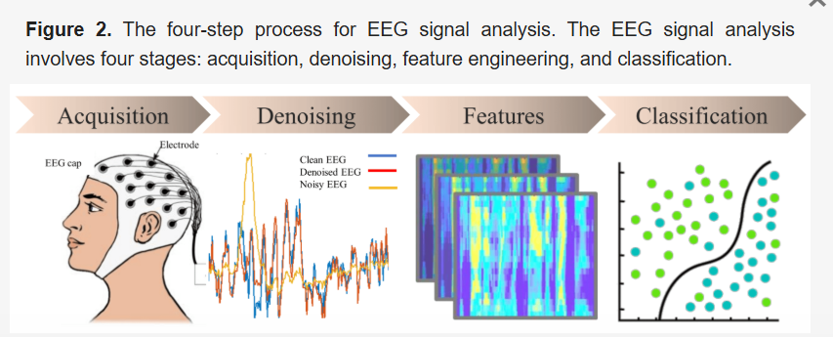
EEG (Electroencephalogram) Analysis
An electroencephalogram (EEG) is a painless brain scan that measures electrical activity in the brain.
It's also known as a brain wave test.
Detecting abnormal brain activity.
Identifying brain tumors, infection, bleeding, brain swelling or head injury.

Slide 17
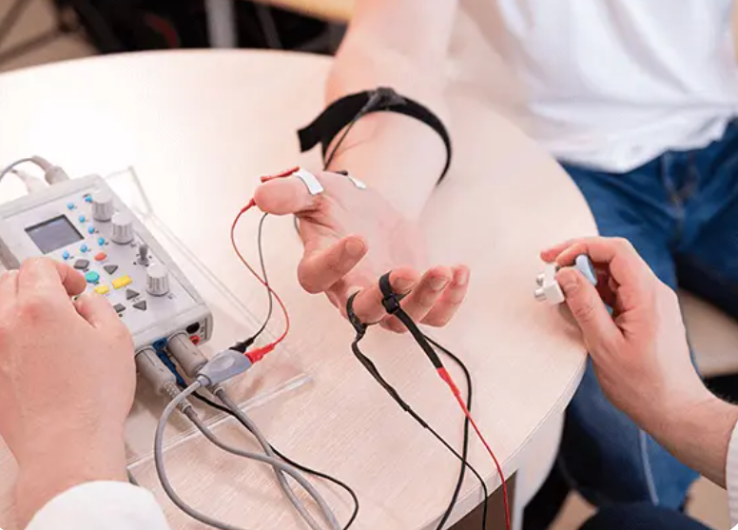
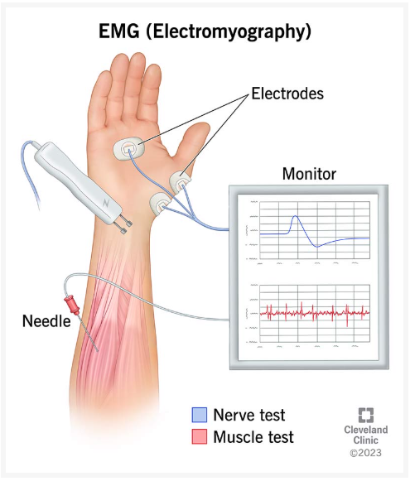
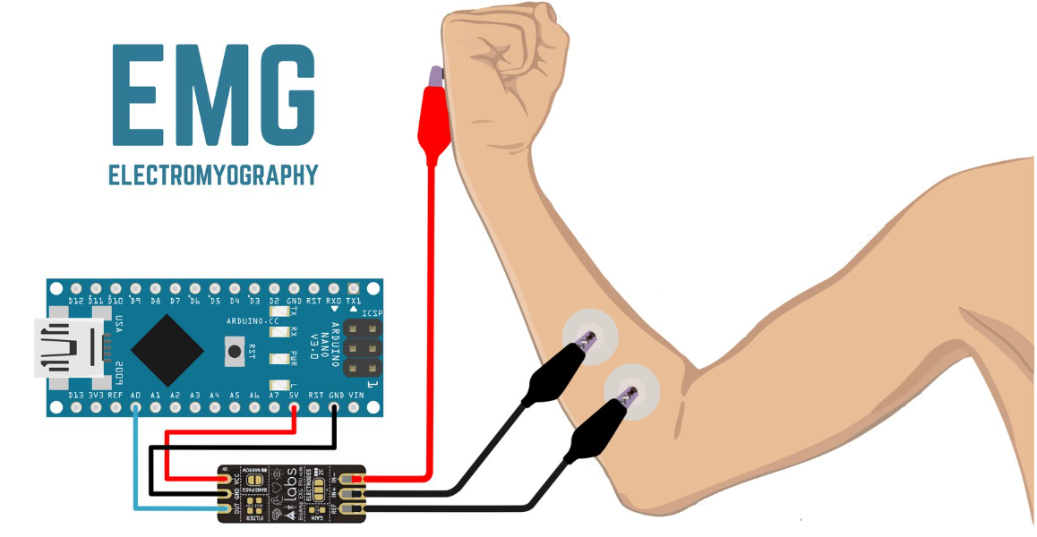
EMG (Electromyogram) Analysis
An electromyogram (EMG) is a test that measures the electrical activity of muscles.
It can help diagnose muscle and nerve disorders.

Slide 18
Advantages of Digital Signal over Analog Signal
Noise Immunity: Digital signals are less susceptible to noise and interference, which means they maintain their integrity during transmission and storage. This is because digital signals are represented as discrete values (0s and 1s), allowing for easier error correction and less distortion.
Higher Transmission Rate: Digital signals can be transmitted at higher speeds compared to analog signals. This is crucial for modern communication systems that require fast data transfer.

Slide 19
Advantages of Digital Signal over Analog Signal
Flexibility and Upgradeability: Digital systems are more flexible and easier to upgrade. They can be easily modified or expanded without significant hardware changes.
Security and Encryption: Digital data can be encrypted and compressed easily, enhancing security and reducing storage requirements.

Slide 20
Advantages of Digital Signal over Analog Signal
Easy Data Manipulation: Digital signals can be edited, manipulated, and configured without altering the original data. This is particularly useful in audio and video editing applications.
Storage and Portability: Digital data can be stored on various media (like CDs, DVDs, and hard drives) and is more portable than analog data.

Slide 21
Advantages of Digital Signal over Analog Signal
Error-Free Reproduction: Copies of digital data can be made without any loss in quality, unlike analog signals which degrade over time and with each copy.
Observational Accuracy: Digital instruments eliminate observational errors such as parallax and approximation errors, providing more accurate readings.

Slide 22
Biomedical Signals and Systems
Biomedical signals and systems is a field that applies signals and systems theory to living systems.
It involves acquiring and analyzing physiological signals, such as brain activity, heart rhythm, and muscle movement.
It involves acquiring and analyzing physiological signals, such as brain activity, heart rhythm, and muscle movement.

Slide 23
Biomedical Signals and Systems
Applications
Digital health: Research to improve remote healthcare and prehospital care
Neuro engineering: Research to develop bio electrodes etc.
Techniques
Time-domain: Analyzes the waveform of a signal over time
Frequency-domain: Analyzes the frequency components of a signal.

Slide 24
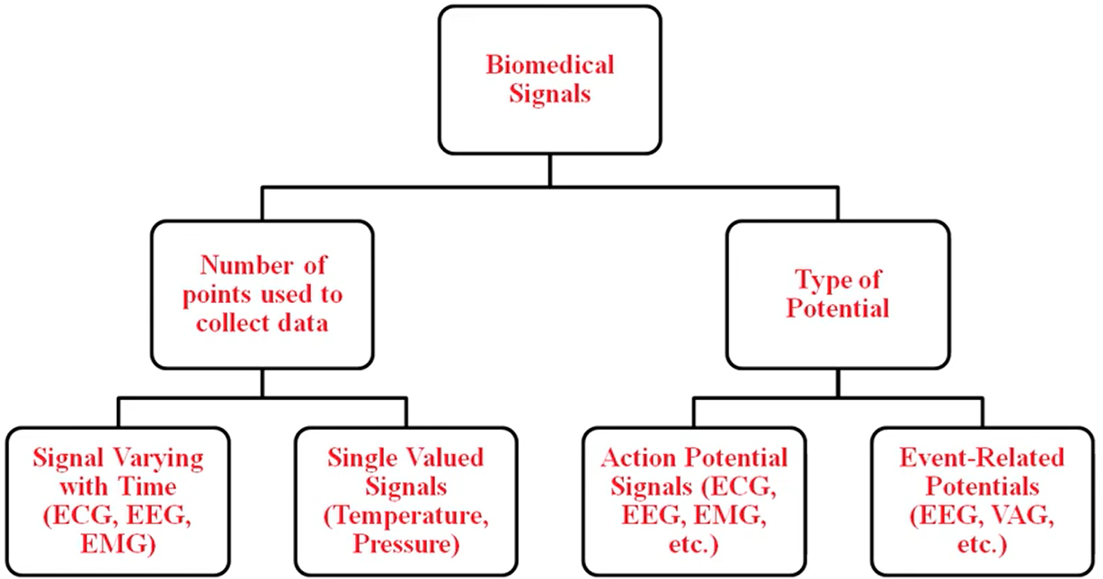
Biomedical Signals
Biomedical signals are observations of physiological activities ranging from gene and protein sequences, to nerve conduction and cardiac rhythms, to tissue and organ images.

Slide 25
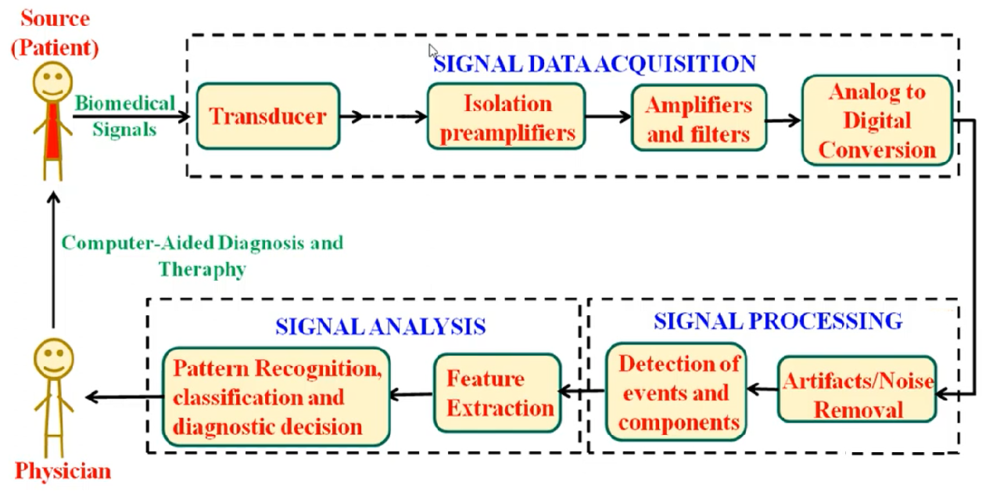
Computer-Assisted Diagnosis based on Biomedical Signal Processing and Analysis

Slide 26
Sampling And Quantization
Sampling and quantization are processes that convert analog signals into digital signals.
They are the foundation of analog-to-digital conversion (ADC).

Slide 27
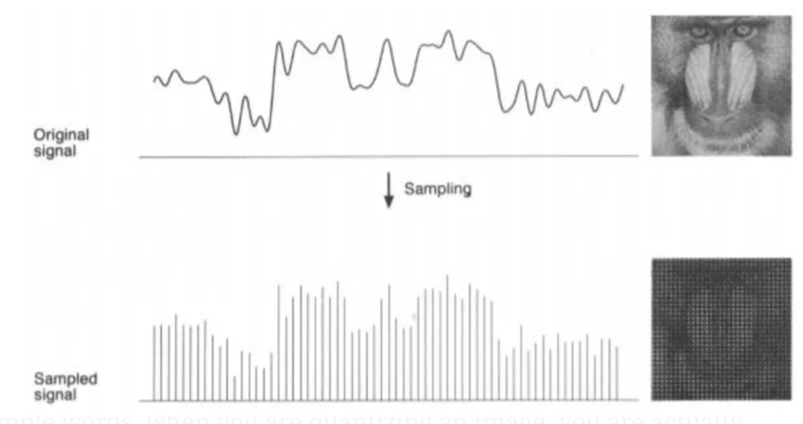
Image Signal Sampling

